Slide 1

Analysis of rating of Coffee Shops in Riyadh
Presented by
wafa albattah and Taghreed albaiz

Slide 2
About lava coffe
From the personalities in which they exist to the communities that grow our coffee beans, we are committed to investing and creating opportunities to positively impact people's lives.
Exchanging groups, helping at work, bringing activism into work, bringing activism into individuals - all this is an axe part of our identity as a sustainable company.
As a publicly traded company, lava coffee believes in striking a balance.
between business and social amenities

Slide 3
People say money can’t buy happiness. They lie. Money buys coffe , coffe makes me happy!

Slide 4
Tools
Python
SQL
Jupyter
notebook
panda
Numpy
Matplotlib

Slide 5
Data Cleaning
Check nulls
Fix columns
Remove columns

Slide 6
The data was taken from the Kaggle website: https://www.kaggle.com/mohammedhalosaimi/riyadh-coffee-shops

Slide 7
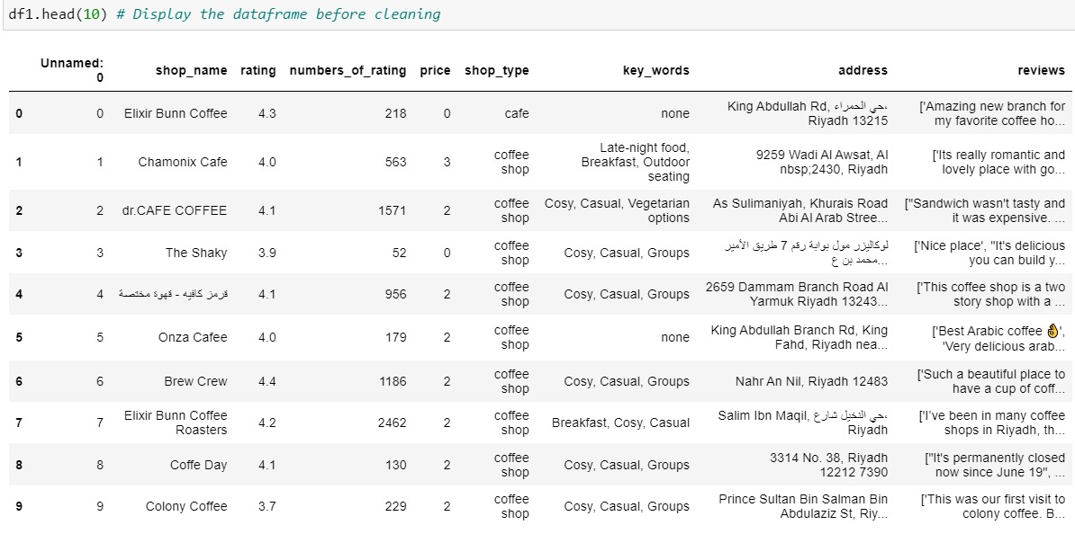
DataFrame:

Slide 8
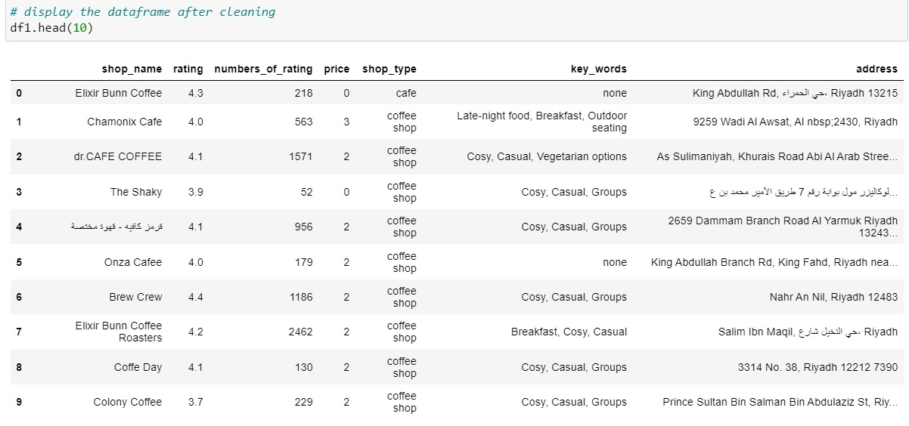
DataFrame:

Slide 9
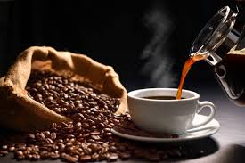
Analysis of rating of Coffee Shops in Riyadh
The goal of the project is to analyze Riyadh cafes based on people’s ratings of most cafes in Riyadh and based on this ratings we will establish a Lava coffee shop.

Slide 10
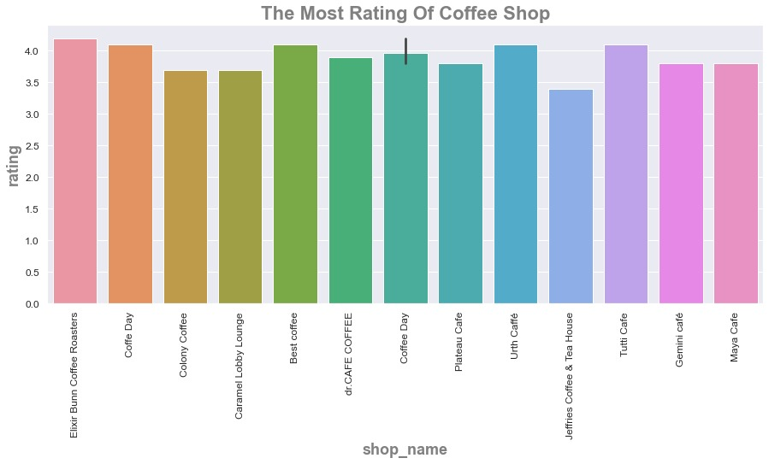

Slide 11
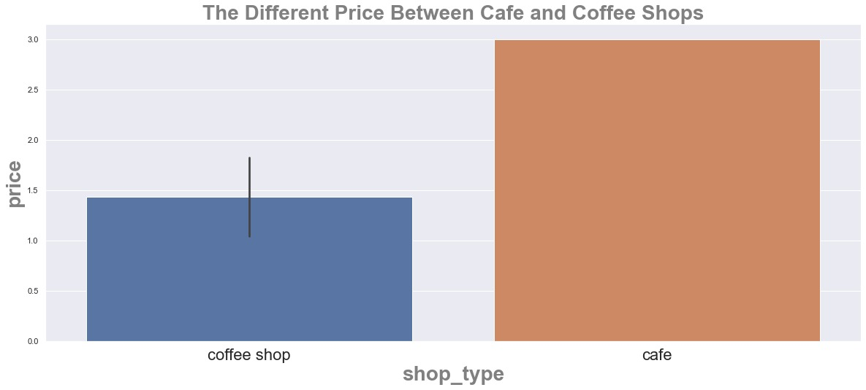

Slide 12
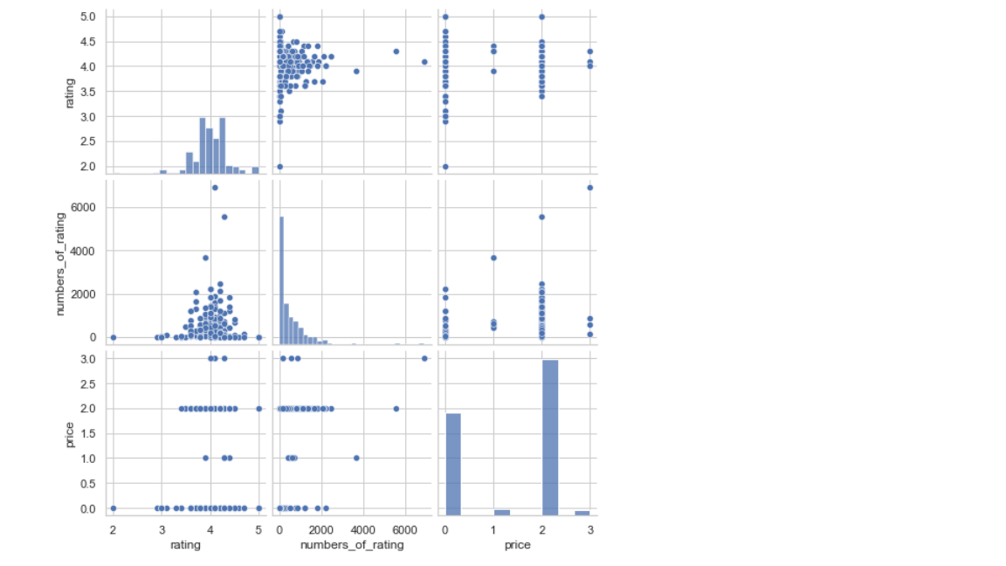

Slide 13
conclusion
From my first impression we get an answer for:
what's the most coffee shop has highest rating based on quality of coffee and the price?
and after analysis we noticed the “Elixir Bunn coffee Roasters” has the highest rating.

Slide 14
THANKS!

